Slide 1


GLOBAL ILLUMINATION IN GODOT ENGINE
Pedro J. Estébanez (a.k.a. RandomShaper)
CC BY-SA 4.0

Slide 2
FOUNDATION

Slide 3
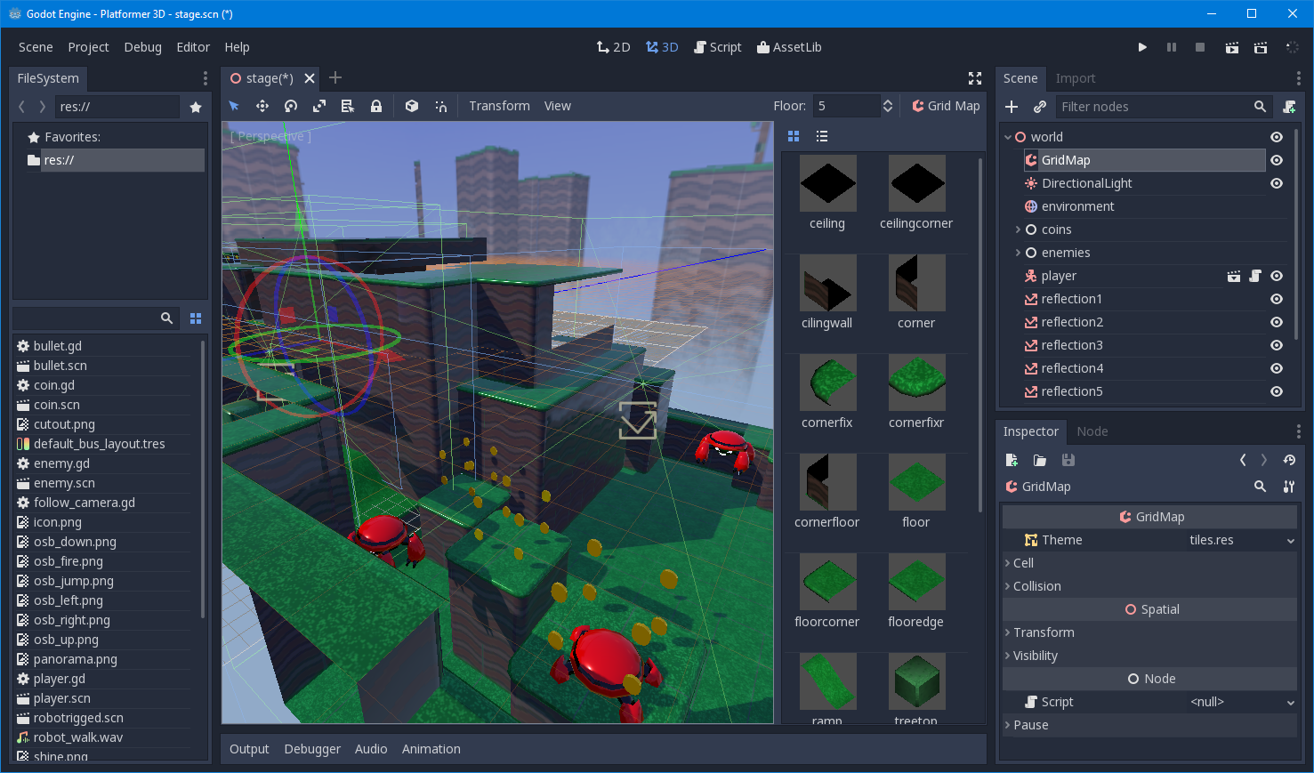
Game engine + Editor
2D & 3D
Full of visual tools
Very easy to learn

Slide 4









CROSSPLATFORM
Desktop · · · · · · (games + editor)
Mobile · · · · · · ·
Web · · · · · · · · · (WebAssembly)
Consoles · · · · · · (via 3rd-parties)

Slide 5
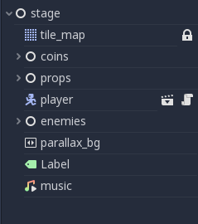
Everything is a node
A scene is a node, too
Organization is promoted (instancing, inheriting, nesting)
Low-risk parallel work for teams
Programmers and artists can collaborate without interference

Slide 6
MAIN FEATURES

Slide 7
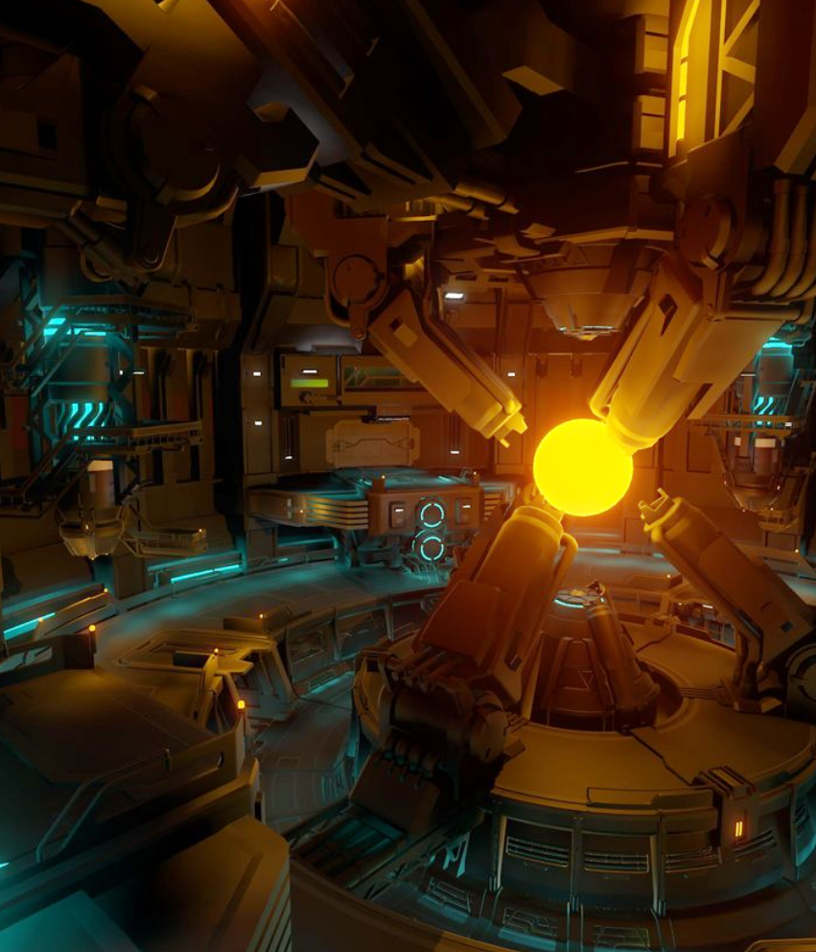
STATE-OF-THE-ART 3D
Physics Based Rendering
Real-time Global Illumination
Most common effects supported (Tone-mapping, SSAO, SSR…)

Slide 8
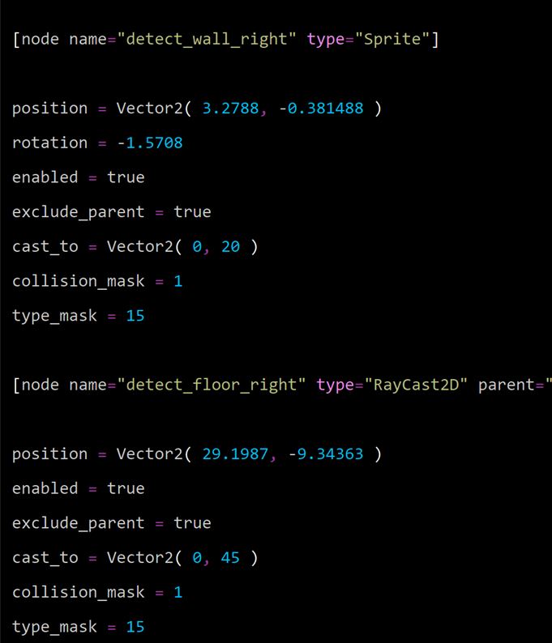
VCS (AND HUMAN) FRIENDLY
Almost everything consists in plain text files
VCS-friendly format (nice diffs)
Easy to read/edit by humans alike

Slide 9
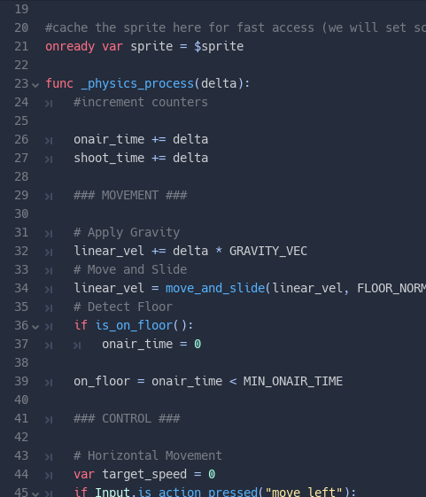
MULTIPLE LANGUAGES
GDScript
C# 7.0 (via Mono)
Visual Scripting
C++ (NativeScript)
Unofficial: Nim, Rust, Python, D

Slide 10
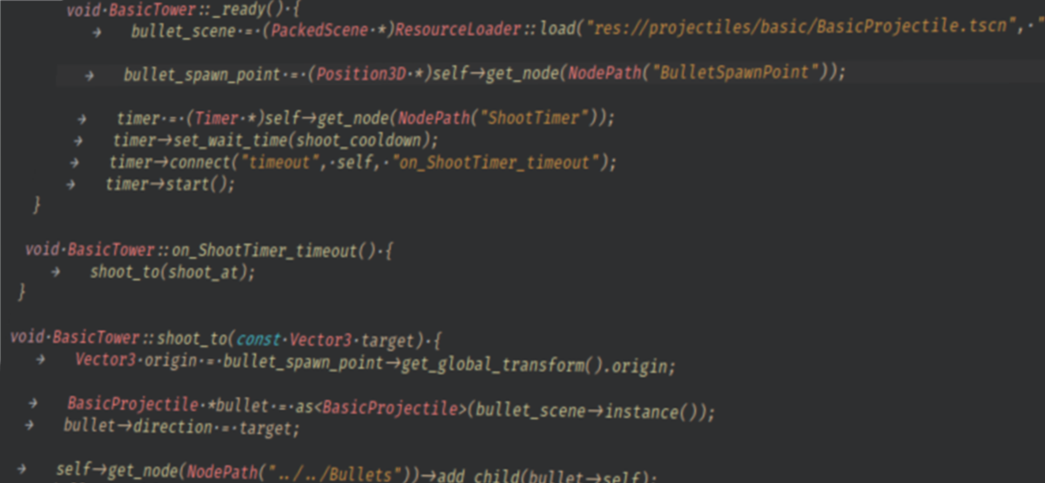
EXTENSIBLE
Plugin architecture
Asset library
GDNative

Slide 11
DEVELOPMENT

Slide 12


OPEN SOURCE
Open-sourced in 2014
Hosted on GitHub
Travis + AppVeyor CI
MIT License

Slide 13
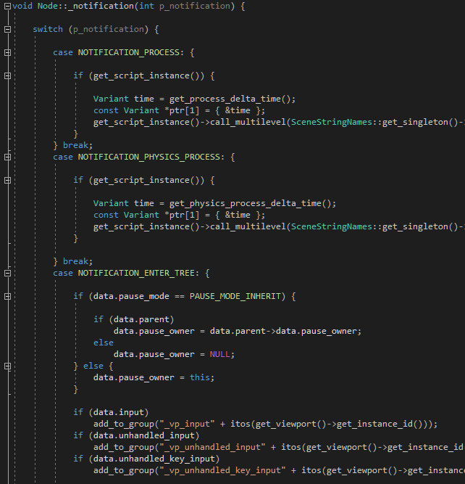
The code itself
SCons build system
~1 M lines of C++03
clang-formatted
Not using STL
Custom containers and String (Vector, List, Map…)
Very dev-friendly

Slide 14
ARCHITECTURE

Slide 15
Engine ⟷ outside world
OS
OS services
OpenGL (ES)
Platform abstraction
Generalist OS abstraction
Audio driver (WASAPI, PulseAudio…)
Rasterizer
⇑ RasterizerGLES3
InputDefault
Misc. APIs (Filesystem, network, clock, window…)
AudioServer
VisualServer
⇑ VisualServerRaster

Slide 16
Engine ⟷ GAME
InputDefault
Misc. APIs (Filesystem, network, clock, window…)
AudioServer
VisualServer
⇑ VisualServerRaster
AudioPlayer
Sprite, Button, MeshInstance, Light…
Code
Scenes
Assets
Resource system
SceneTree
PhysicsServer
⇑ PhysicsServerSW BulletPhysicsServer
Physics2DServer
⇑ Physics2DServerSW
RigidBody, HingeJoint…

Slide 17
GLOBAL ILLUMINATION (GI)

Slide 18
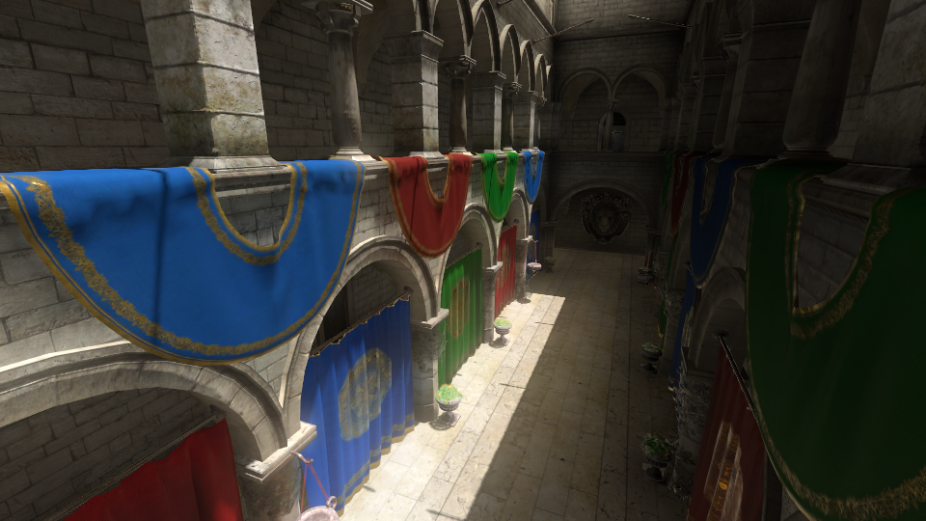
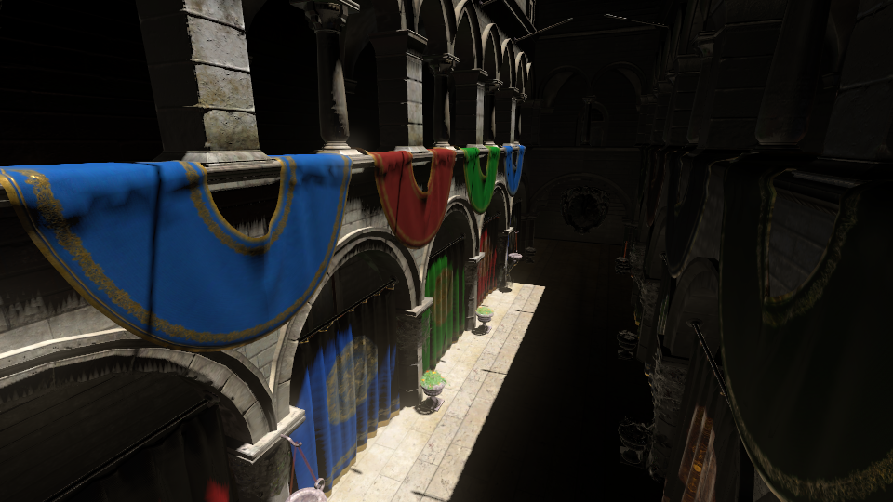
GI CONTRIBUTION
Reflection probe + SSAO + Glow
+ GI probe

Slide 19
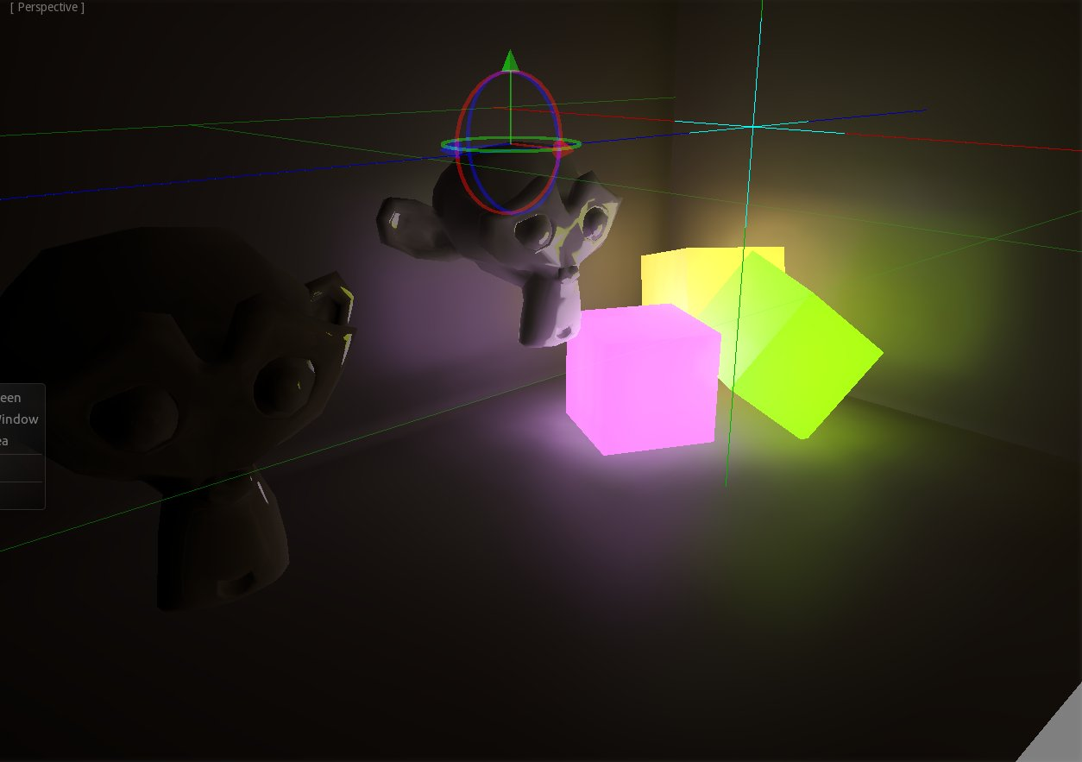
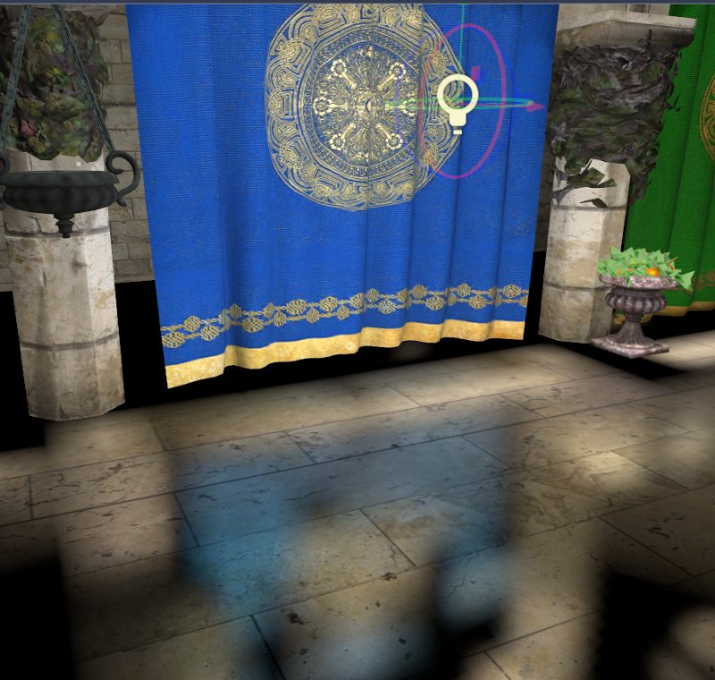
GI CONTRIBUTION
Emissive materials
Reflections

Slide 20

Tradeoffs
High quality indirect light
Not-so-costly to render
Dynamic objects are affected in real time
Memory-hungry
Too expensive for mobile
Voxelization can be evident

Slide 21
PROCESS
CPU
GPU
1
2
3
Scene GIProbe
VisualServer
Rasterizer
Static pre-bake: Voxelize albedo + emission + normal from static geometry
Light management: Add/update/remove lights influence
Rendering:
Apply indirect lighting to meshes
GIProbeData
GL_TEXTURE_3D

Slide 22
GIProbe
CPU
GPU
1
2
3
Scene GIProbe
VisualServer
Rasterizer
Static pre-bake: Voxelize albedo + emission + normal from static geometry
Light management: Add/update/remove lights influence
Rendering:
Apply indirect lighting to meshes
GIProbeData
GL_TEXTURE_3D

Slide 23
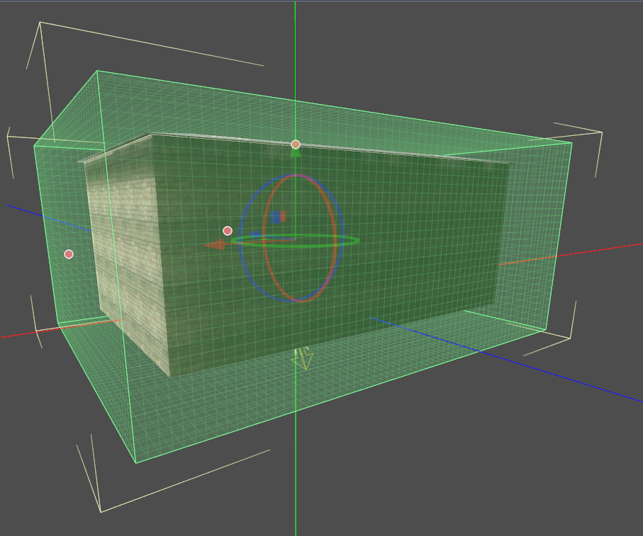
1. GIProbe

Slide 24
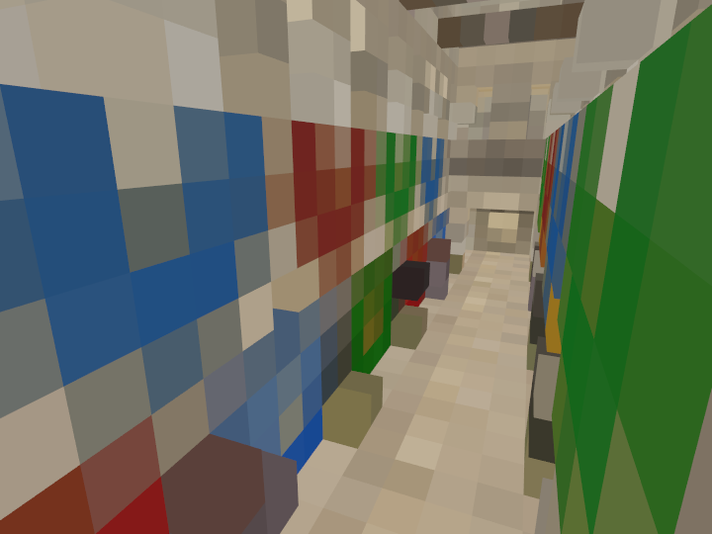
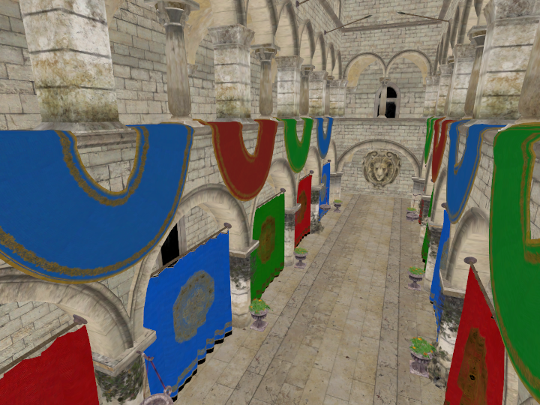
1. GIProbe
Voxels always cubic
2^{n} voxels on every axis

Slide 25
1. GIProbe
Pre-bake (usually done at the editor):
Per every affected MeshInstance (intersecting AABB)
per surface, per face
plot(face, root_cell, 0, probe_aabb)
fixup() // Average alphas (presence coefficient)
Serialize to a BLOB (GIProbeData, PoolVector<int>)
clamp to [0, 1]
float to uint8_t

Slide 26
1. GIProbe
plot(face, cell, level, aabb):
if level < max_level:
for child_cell of split(cell):
if not face in aabb skip
plot(face, child_cell, level + 1, child_cell.aabb)
else:
subcell_data = 0 // albedo, emission, normal, alpha
for subcell of subdivide(cell, 4, 4, best_axis(face)):
if not face in subcell.aabb skip
subcell.aen += raycast_sample(…) subcell.alpha += 1
cell.data += subcell_data / (4 * 4)

Slide 27
2. VisualServer
CPU
GPU
1
2
3
Scene GIProbe
VisualServer
Rasterizer
Static pre-bake: Voxelize albedo + emission + normal from static geometry
Light management: Add/update/remove lights influence
Rendering:
Apply indirect lighting to meshes
GIProbeData
GL_TEXTURE_3D

Slide 28
2. VisualServer
Per frame, per GIProbe
STAGE_LIGHTING
Invalid
STAGE_CHECK
Update voxelized light in a dedicated thread
Done
Check invalid:
Not set up or propagation param changed
Light cache changed
If not set up:
Initialize LocalData cells with emission from GIProbeData (storing energy as unint16_t[3])
If any of them:
Enqueue update
STAGE_UPLOADING
Send data to the Rasterizer (update GL_TEXTURE_3D in a GL backend)

Slide 29
2. VisualServer
STATE_LIGHTING:
Update voxelization in local_data upon scene GIProbeData and lights:
Per each light removed or changed
bake_light(light, -1) // Deterministic
Per each ight added or changed
bake_light(light, +1) // Deterministic
Recursively downsample up to the first level
Build final data, ready to be sent to the Rasterizer (even right as S3TC if wanted):
Mip-map chain, each texel computed as:
texel.rgb = local_cell.energy / probe.dyn_range
texel.a = probe_cell.alpha

Slide 30
2. VisualServer
bake_light(light, sign):
for each cell:
cell_hit = track(light, cell)
if cell_hit == cell:
light_rgb = light.color * light.energy
local_data_cell.energy +=
gi_probe_data.cell.albedo * light_rgb

Slide 31
2. VisualServer
Once slice of the GL_TEXTURE_3D (128x64x128)

Slide 32
3. Rasterizer
CPU
GPU
1
2
3
Scene GIProbe
VisualServer
Rasterizer
Static pre-bake: Voxelize albedo + emission + normal from static geometry
Light management: Add/update/remove lights influence
Rendering:
Apply indirect lighting to meshes
GIProbeData
GL_TEXTURE_3D

Slide 33
3. Rasterizer
Per frame, VisualServer associates GIProbes with affected meshes.
The Rasterizer picks two at most for a given mesh, and sets these uniforms:
uniform mediump sampler3D gi_probe1;
uniform highp mat4 gi_probe_xform1;
uniform highp vec3 gi_probe_bounds1;
uniform highp vec3 gi_probe_cell_size1;
uniform highp float gi_probe_multiplier1;
uniform highp float gi_probe_bias1;
uniform highp float gi_probe_normal_bias1;
uniform bool gi_probe_blend_ambient1;
# The same for the 2nd probe (gi_probe...2)

Slide 34
3. Rasterizer
Per every GI-affected mesh:
Per every fragment:
Sum indirect lighting, computed as a weighted average of the light inside N cones
Low quality: N = 4 cones
High quality: N = 6 cones
In any case, 1 more for specular
Cone 2 w = 1/3
Cone 1 w = 1/3
N
Cone 3 w = 1/3
fragment

Slide 35
3. Rasterizer
Voxel Cone Tracing
At each step:
Accumulate alpha
Accumulate textureLod(pos, LOD) * (1.0 – accum_alpha)
fragment
max_distance
Exit condition: dist > max_distance || accum_alpha >= 0.95
Unit is voxel side
D = diameter = max(1.0, 2 * tan(angle / 2) * dist) LOD = log2(D)

Slide 36
3. Rasterizer
fragment
max_distance
dist = bias = 1.0
D = 1.0 LOD = 0
Avoid self-occlusion

Slide 37
3. Rasterizer
fragment
max_distance
dist += old_D / 2 = 1.5
D = 1.0 LOD = 0

Slide 38
3. Rasterizer
fragment
max_distance
dist = 2.0
D = 1.071 LOD = 0

Slide 39
3. Rasterizer
fragment
max_distance
Quadrilinear interpolation
dist = 2.54
D = 1.36 LOD = 0.444

Slide 40
3. Rasterizer
fragment
max_distance
dist = 3.22
D = 1.73 LOD = 0.790

Slide 41
THANK YOU!

Slide 42
QUESTIONS
?

Slide 43

THANK YOU!
See you soon at
https://randomshaper.blogspot.com
Support Godot on

